Slide 1
SQUARES AND SQUARE ROOTS

Slide 2
Session 3 Topics to be covered
Word Problems on Prime Factorization
Square Root by Long Division Method

Slide 3
Word Problems on Prime Factorization
Do all the examples in CW notebook and homework questions in HW notebook
Worksheet 3
Q2. Find the smallest number by which 1100 must be multiplied so that the product becomes a perfect square. Also, find the square root of the perfect square so obtained.
Soln: Prime factorization of 1100
1100 = 2 x 2 x 5 x 5 x 11
We observe that prime factor 11 does not form a pair.
So we must multiply 1100 by 11 so that the product becomes a perfect square.
2 | 1100
2 | 550
5 | 275
5 | 55
11 | 11
 | 1

Slide 4
1100 x 11 =12100
12100 = 2 x 2 x 5 x 5 x 11 x 11
√12100 = 2 x 5 x 11 = 110
Let us take one more example

Slide 5
HOMEWORK
Now do Q3 and Q4 of WS 3 in HW notebook.
WS -3
Q5.A gardener planted 1521 trees in rows such that the number of rows was equal to the number of plants in each row. Find the number of rows.
Soln: Let the number of rows be a.
So number of plants in each row is also a.
Therefore, a x a = 1521
a² = 1521
a = √ 1521
Prime factorization of 1521
1521 = 3 x 3 x 13 x 13
√1521 = √(3 x 3 x 13 x 13 )
= 3 x 13
= 39
So a = 39
Hence, number of rows are 39.
3 | 1521
3 | 507
13 | 169
13 | 13
 | 1

Slide 6
HOMEWORK
Now do Q6 of WS 3 in HW notebook.
WS -3
Q7. The area of a square field is 5184 m². A rectangular field, whose length is twice its breadth, has its perimeter equal to the perimeter of the square field. Find the area of the rectangular field.
Soln: Let the side of square field be ‘a’ m.
Area of square field = a x a = a²
a² = 5184
a = √5184
a = √(2 x 2 x 2 x 2 x 2 x 2 x 3 x 3 x 3 x 3)
= 2 x 2 x 2 x 3 x 3
= 72
Thus, side of square field is 72 m.
Perimeter of square field = 4 x side
= 4 x 72 m = 288 m
2 | 5184
2 | 2592
2 | 1296
2 | 648
2 | 324
2 | 162
3 | 81
3 | 27
3 | 9
3 | 3
 | 1

Slide 7
Now let breadth of rectangular field be ‘b’ m so length is ‘2b’ m.
Perimeter of rectangular field = Perimeter of square field
2 (2b + b) = 288
2 x 3b = 288
6b = 288
b = 288/6 = 48
So breadth = 48 m
length 2 x breadth = 2 x 48 m = 96m
Area of rectangular field = length x breadth
= (96 x 48) m²
⁼ 4608 m²

Slide 8
Long Division Method
When numbers are very large, the method of finding their square roots by prime factorization becomes lengthy. So, we use long division method.
Lets understand the method with the help of an example.
Example: Find the square root of 1521.
Step 1: Mark off the digits in pairs starting with ones digit. Each pair and remaining one digit (if it is there) is called a period.
Step 2: Write the largest number whose square is either equal to or just less than the first period starting from left. This digit becomes the quotient as well as divisor.
Step 3: Find the remainder. Write down the next pair of digits (i.e. second pair) to the right of remainder. This becomes the new dividend.
15 21
 | 3
3 | 1521
 | 9
 | 6
 | 3
3 | 15 21
 | 9
 | 6 21

Slide 9
Step 4: Double the current quotient (here, 3 x 2 = 6) and enter its divisor with a blank on its right.
Step 5: Now guess a largest possible digit to fill the blank which also becomes the new digit in the quotient such that when new digit is multiplied to the new divisor, the product is either less than or equal to the dividend.
Step 6: Now subtract the product of new divisor and the new digit from the new dividend. If the remainder is zero and no period is left , then we stop and the current quotient is the square root of the given number. And if the remainder is non – zero then repeat the step from4 to 6 till all the periods have been taken care of.
So here √1521 = 39.
 | 3
3 | 15 21
 | 9
6 _ | 6 21
 | 3 9
3 | 15 21
 | 9
6 9 | 6 21
 | 6 21 | (69 x 9)
 | 0

Slide 10
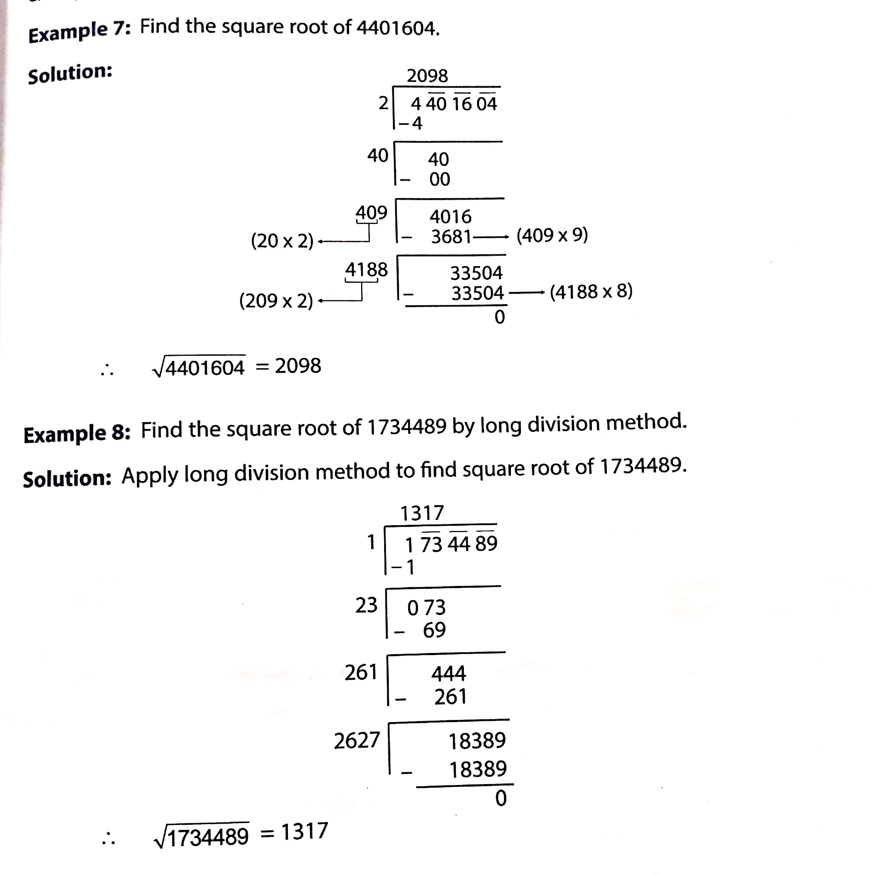
Lets take some more examples to understand the method.

Slide 11
Now watch the following video
https://www.youtube.com/watch?v=Ga1_wuLz0QM
Do WS - 4 Q1(i),(iii),(vi) and (viii) in CW notebook and Q1 (ii), (iv), (v) and (vii) in HW notebook.

